Slide 1



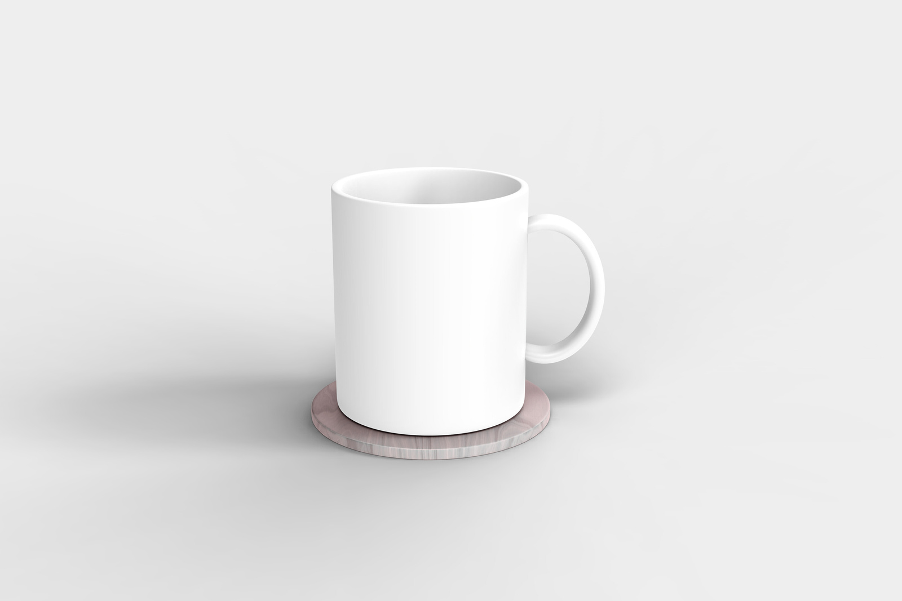

SMART
COASTER
智慧杯墊
TEAM2
M11451001 楊婕
M11451007 楓尹翔
M11451011 簡翊程
M11451027 顏梓淮
M11451029 吳家瑜
START PRESENTATION
1

Slide 2


Contents
System architecture
Topic
02
03
01
Hardware
04
Software
05
Bill of materials
06
Assignment
2

Slide 3



01
Topic
Have You Had Water Today ?
An Overlooked Office Wellness Problem
The Cost of Deep Work
When was the last time you took a sip of water?
Busyness as the Norm
The Invisible Health Hazard
office worker
3

Slide 4
01
Topic
Existing
Solutions
Mobile Apps / Desktop Software
Smart Bottles
Manual Entry
Irrelevant Notifications
High Cost
Container-Specific
Our
Solution
Low Cost
Zero-Effort Automatic Tracking
Smart Reminders with LED Light
Use your existing drinkware
Smart Coaster
4

Slide 5


02
System architecture
HX711 + Pressure Sensor Module
Bakelite board
LED Light Strips
Button
Physical Layer
ESP32 maintains a session with the Blynk cloud server (Wi-Fi/BLE connection)
Session Layer
Data Link Layer
ESP32 Wi-Fi / BLE
analog → digital
Format the data and send it to Blynk App
Presentation
Layer
Network Layer
ESP32 Wi-Fi IP Address
Application
Layer
Display the user interface through the Blynk IoT platform and Arduino IDE program
Use BLE packet transmission protocol to transmit sensor data
Transport Layer
5

Slide 6
03
Hardware
1.Weight sensor
4.Button
2.Perfboard
5.ESP32
3.LED Light Strips
6

Slide 7

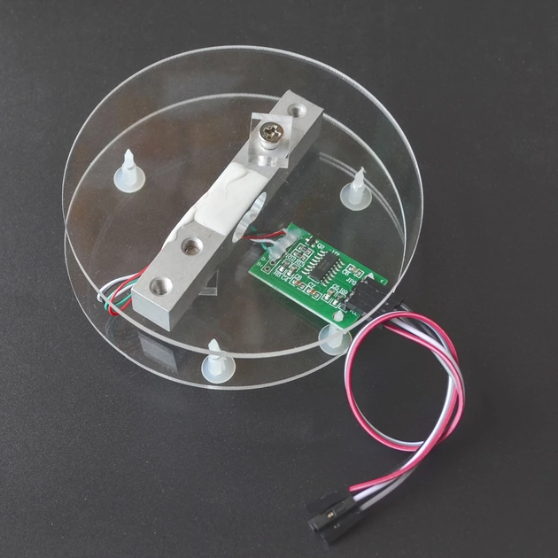
Weight sensor
Model: HX711 + Pressure Sensor Module (5kg)
Purpose: Amplifies the signal received by the Load Cell and transmits it to the HX711, which converts the analog signal into a digital signal and transmits it to the ESP32.
7

Slide 8
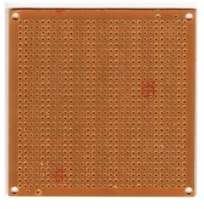
Perfboard
Size: 85mm*85mm (900 holes)
Purpose: To integrate all components
8

Slide 9
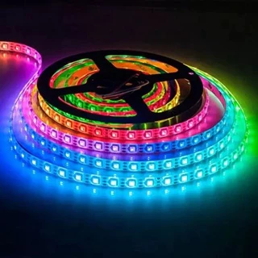
LED Light Strips
Model: ws2812b
Size: 24 LEDs, approximately 40cm
Purpose: To remind customers when it's time to drink or refill their water bottle
9

Slide 10
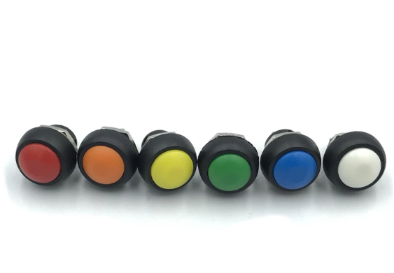
Button
Model: PBS-33B Reset (non-locking) button
Purpose: Returns the weight of a cup placed on a coaster to zero.
10

Slide 11
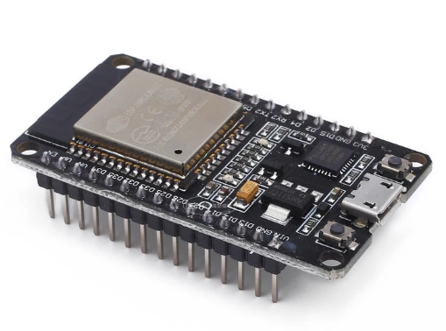
ESP32
Purpose:
1.Data Acquisition and Control: Receives digital signals (DT/SCK) from the HX711 module, calculates them, and converts them into actual weight (grams/ml of water or beverage).
Control Output: Based on the calculated results, precisely controls the color, brightness, and dynamic effects of the WS2812B light bar.
Input Processing: Monitors the status of the PBS-33B button and performs zero reset operations.
2. Smart Connectivity: This is the most powerful feature of the ESP32. It can transmit weight and hydration data to a cloud server via Wi-Fi or to a mobile app via Bluetooth (BLE).
3. Logical Operations and State Management: Runs the Arduino program
11

Slide 12
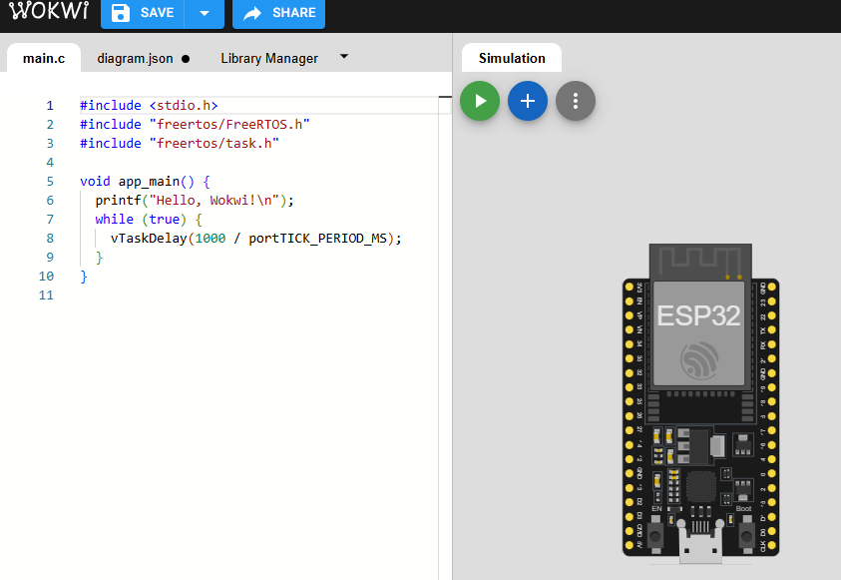
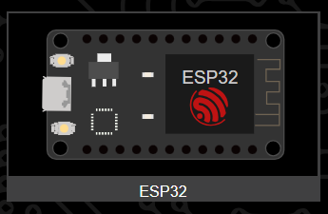
04
Software －WOKWI
Test the operation and program execution of ESP32 on the development board. Verify the feasibility of the required hardware and software resources to ensure that their specifications and functions fully meet the design requirements.
12

Slide 13
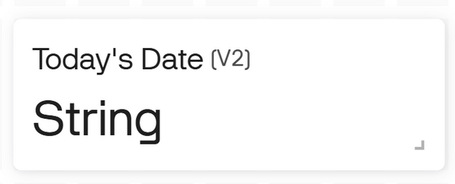
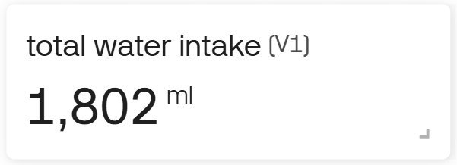
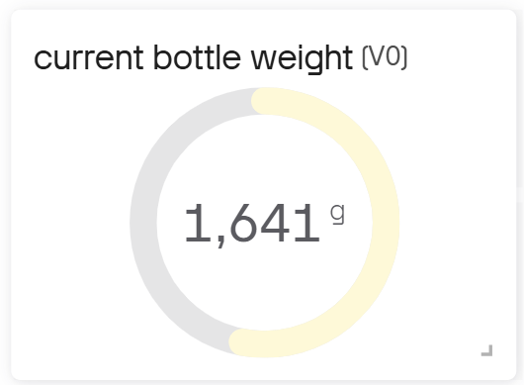
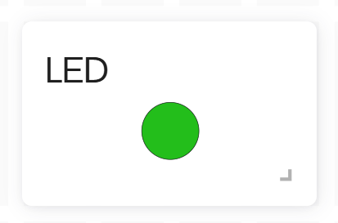
04
Software －Blynk IoT platform
Functions are shown on the User Interface Display
2025/10/30
water level is insufficient－RED
water level is sufficient－GREEN
13

Slide 14
04
Software －Arduino IDE
Current bottle
weight
Today's water
intake
Reminder to
fill water
Record date
ESP32 connect to Wi-Fi
Reset the bottle's weight to zero
Detect when a drinking event occurs
Use a library function to make the LED light up
Use a library function to get today's date
Measure the bottle's weight
Add the decreased water amount to today's total water intake
If the water weight is below 100g, then turn on the red light
Record today's total water intake to the data table at 23:59
Reset the accumulated water intake to zero at the start of each new day
14

Slide 15
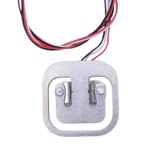
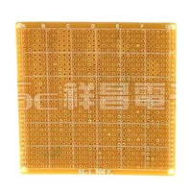

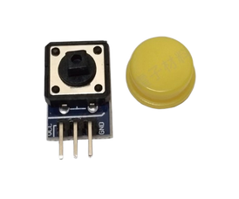
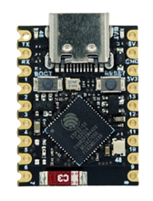
05
Bill of Materials
numbers | parts | specification | quantity | price (NT) | picture | reference website
1 | weight sensor | Measures the weight of items placed on the coaster to provide data input for intelligent judgment. | 1 | 25
2 | bakelite board | As the main structural material of the coaster, it provides a stable and insulating base. | 1 | 25
3 | LED light strip | Provides visual feedback to indicate the status of the water volume (e.g., when to drink water , when to refill water ). | 1 | 6
4 | botton | Provides a manual input interface for users to reset, power on or off, or switch functions. | 1 | 8
5 | ESP32 | The project's core microcontroller is responsible for data processing, Wi-Fi/Bluetooth connections, and controlling all peripheral hardware. | 1 | 255
https://shopee.tw/%E3%80%90%E5%8F%B0%E7%81%A3%E7%89%A9%E8%81%AF%E3%80%9150kg%E7%A7%A4%E9%87%8D%E6%84%9F%E6%B8%AC%E5%99%A8-%E4%BA%BA%E9%AB%94%E7%A7%A450KG%E9%9B%BB%E9%98%BB%E6%87%89%E8%AE%8A%E5%8D%8A%E6%A9%8B%E5%BC%8F%E6%84%9F%E6%B8%AC%E5%99%A8-i.10207300.848013561?sp_atk=cc23c6ce-57ce-474b-a757-35cf7af70ac3&xptdk=cc23c6ce-57ce-474b-a757-35cf7af70ac3
https://shopee.tw/%E3%80%90%E7%A5%A5%E6%98%8C%E9%9B%BB%E5%AD%90%E3%80%91KT-1-SL-1-%E9%9B%BB%E6%9C%A8%E6%9D%BF(900%E5%AD%94)-J-1-%E8%90%AC%E7%94%A8%E6%9D%BF-%E9%9B%BB%E8%B7%AF%E6%9D%BF-PC%E6%9D%BF-PCB-%E6%B4%9E%E6%B4%9E%E6%9D%BF-%E5%AF%A6%E9%A9%97%E6%9D%BF-%E7%B7%9A%E8%B7%AF%E6%9D%BF-i.27742636.5048744441?sp_atk=98ef8bfe-469b-4fb2-8914-00211cf7c015&xptdk=98ef8bfe-469b-4fb2-8914-00211cf7c015
https://shopee.tw/%E8%97%8D%E5%85%89(%E5%8F%AF%E5%AE%A2%E8%A3%BD%E5%8C%96%E9%95%B7%E5%BA%A6)-12V%E9%9C%93%E8%99%B9%E7%87%88%E5%B8%B6%E3%80%90%E6%B2%9B%E7%B4%9C%E5%B0%8F%E9%8B%AA%E3%80%9110%E5%85%AC%E5%88%86%E8%B5%B7%E5%AE%A2%E8%A3%BD-LED%E9%9C%93%E8%99%B9%E7%87%88%E5%B8%B6-i.4984330.23369347953?sp_atk=65264f74-9857-4c6d-8ca7-d6bf685e4b8f&xptdk=65264f74-9857-4c6d-8ca7-d6bf685e4b8f
https://shopee.tw/%E3%80%90%E9%80%A0%E7%89%A9%E4%BA%BA%E3%80%91%E3%80%8A%E5%8F%AF%E7%B5%B1%E7%B7%A8%E3%80%8BArduino-%E6%8C%89%E9%88%95%E6%A8%A1%E7%B5%84-%E6%8C%89%E9%8D%B5%E6%A8%A1%E7%B5%84-%E5%A4%A7%E6%8C%89%E9%8D%B5-%E8%BC%95%E8%A7%B8-%E6%8C%89%E9%88%95-%E6%8C%89%E9%8D%B5%E9%96%8B%E9%97%9C-%E9%AB%98%E9%9B%BB%E5%B9%B3%E8%BC%B8%E5%87%BA-5%E8%89%B2-i.899779.7357690068?sp_atk=877e3880-6198-4137-a94f-e5fc6392c2a1&xptdk=877e3880-6198-4137-a94f-e5fc6392c2a1
https://shopee.tw/%E7%84%A1%E5%90%8D%E7%A7%91%E6%8A%80%E5%8E%9F%E5%BB%A0-ESP32-S3-SUPERMINI-%E9%96%8B%E7%99%BC%E6%9D%BF-Type-c-WIFI-%E8%97%8D%E8%8A%BD-%E7%89%A9%E8%81%AF%E7%B6%B2-i.156997135.26626006239?sp_atk=223d752e-1d51-4703-9d3c-ba48e2fffb3d&xptdk=223d752e-1d51-4703-9d3c-ba48e2fffb3d
15

Slide 16
06
Assignment
M11451001 楊婕 | Bill of materials、Hardware
M11451007 楓尹翔 | GitHub website、Presentation
M11451011 簡翊程 | Software、PPT
M11451027 顏梓淮 | Hardware、PPT
M11451029 吳家瑜 | Purchase、Software、PPT
16

Slide 17


THANK
YOU!
17

